Slide 1
TOSCA & Winery

Slide 2













OASIS TOSCA
Topology and Orchestration
Specification for Cloud Applications
100+ participants from 40+ companies:
Goals:
Automation of Deployment and Management
Portability
Interoperability
Vendor-neutral ecosystem

Slide 3
TOSCA Overview
and
Specification for Cloud Applications
Topology
Orchestration
Service Structure
Service Orchestration for
Deployment & Management
Start VM
Install Tomcat

Slide 4
Two Flavors of Processing
Declarative → What?
  Example: “I want this, realize it!”
  Runtime interprets topology
  and does deployment
Imperative → How?
  Example: “First do this, than that.”
  Management plan explicitly describes
  each step
Start VM
Install Tomcat
Notes:
+ For declarative, nothing more than topology is required
# For Imperative, the concept of management plans has been introduced

Slide 5




Example: Using workflows to deploy an application
✓
Online Bookstore
( WAR )
WAR
✓
Web Server
( Tomcat )
OP
Deploy WAR on Tomcat
✓
Operating System
( Ubuntu 12.04 )
Install Tomcat Web Server
OP
✓
Provision VM and OS
VM
( VirtualMachine )
✓
Amazon
EC2
Public Cloud
( AmazonEC2 )
OP
Provisioning Plan

Slide 6
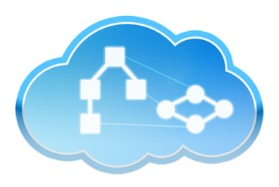
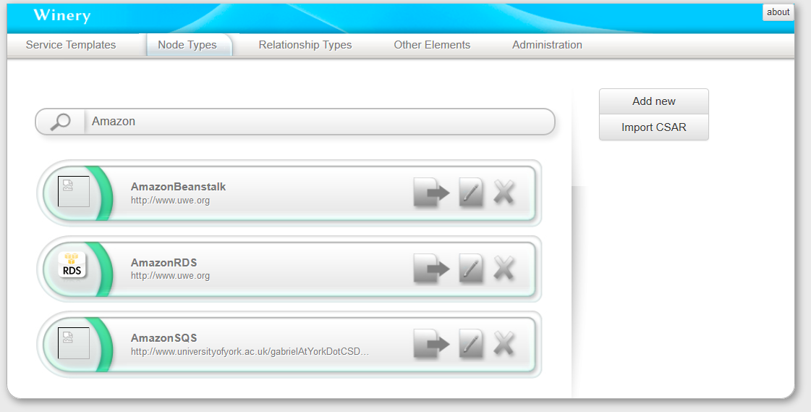
Modeling Tool
Container
Self-Service
Creation and modeling of TOSCA applications, including graphical modeling of topologies and management plans. Exported as Cloud Service Archive (CSAR) for TOSCA runtime.

Slide 7
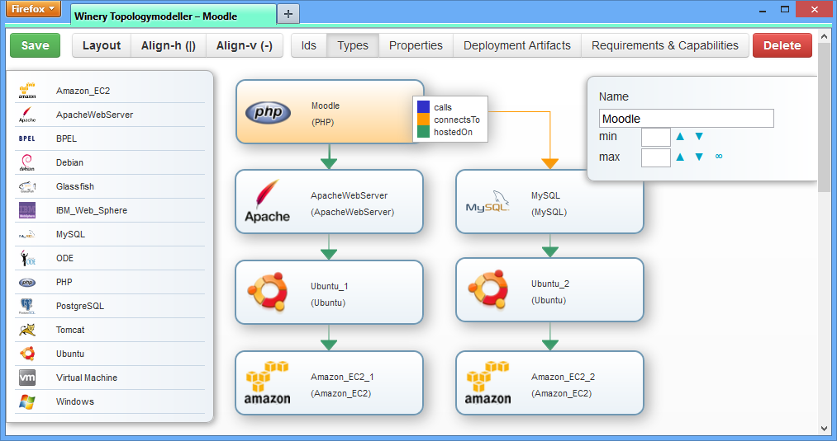
Modeling Tool
Container
Self-Service
Creation and modeling of TOSCA applications, including graphical modeling of topologies and management plans. Exported as Cloud Service Archive (CSAR) for TOSCA runtime.

Slide 8
Online Resources
Demonstrations, Videos,
Publications and Presentations
http://demo.opentosca.org/

